Slide 1
Visualization: a whirlwind tour
Soumya banerjee

Slide 2
1. Data science as (visual) debugging 2. data storytelling to work closely with domain experts 3. Case studies a. genomic data b. forecasting gdp c. mental health outcome prediction
visualization as debugging
Notes:
have you done PCA yet? (have you turned it off and on again?)
Uganda visualization tool (no fancy data science/ML required)

Slide 3

The best statistical graphic ever (Edward tufte) drawn
Notes:
Summer of 1812 Multiple dimensions on one plot
Code and data available see PDF

Slide 4

Important concept
Information bottleneck

Slide 5
generalizations of this idea
tSNE
Autoencoder (non-linear loss function)

Slide 6
pitfalls
tSNE can be used for hypothesis generation.
However There are many pitfalls
https://distill.pub/2016/misread-tsne/
some pitfalls: distances not preserved. For example, a 2d map is a projection from 3D

Slide 7
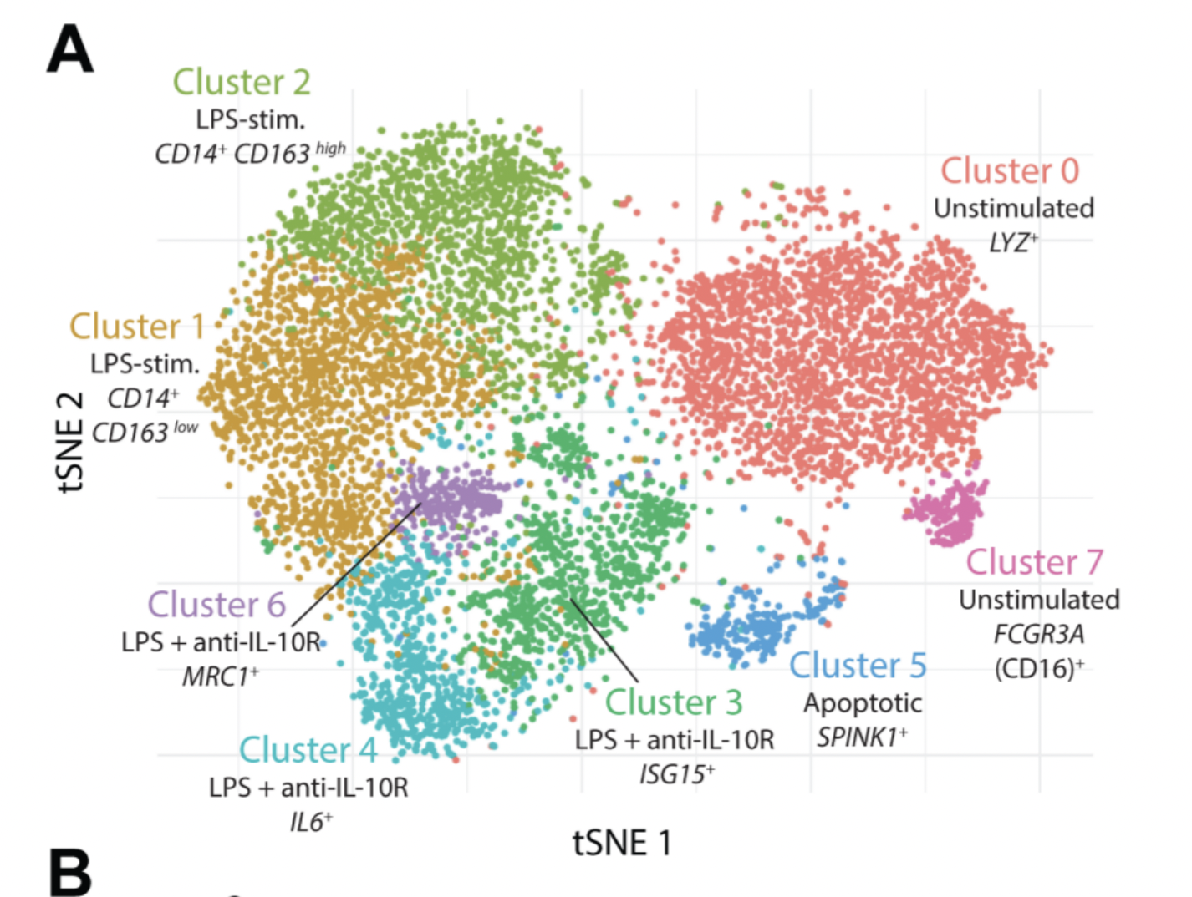
Case study
a. stochastic b. distances not preserved c. difficult to communicate to non-technical experts
Notes:
Example of IL10 project (tSNE and heatmaps from a bioinformatics project)

Slide 8
Visualizations can be misleading
1. distances not preserved in tsne
https://distill.pub/2016/misread-tsne/ 2. cluster sizes do not matter 3. you can see some shapes sometimes
4. random does not always look random
Notes:
Example of IL10 project (tSNE and heatmaps from a bioinformatics project)

Slide 9

Visualizations can be misleading
But what if the two clusters have different standard deviations, and so different sizes? (By size we mean bounding box measurements, not number of points.) Below are t-SNE plots for a mixture of Gaussians in plane, where one is 10 times as dispersed as the other.
Cluster sizes do not mean anything
But what if the two clusters have different standard deviations, and so different sizes? (By size we mean bounding box measurements, not number of points.) Below are t-SNE plots for a mixture of Gaussians in plane, where one is 10 times as dispersed as the other.
Surprisingly, the two clusters look about same size in the t-SNE plots. What’s going on? The t-SNE algorithm adapts its notion of “distance” to regional density variations in the data set. As a result, it naturally expands dense clusters, and contracts sparse ones, evening out cluster sizes.
Notes:
Example of IL10 project (tSNE and heatmaps from a bioinformatics project)

Slide 10

Visualizations can be misleading
Distances between clusters may not mean anything
diagrams show three Gaussians of 50 points each, one pair being 5 times as far apart as another pair.
At perplexity 50, the diagram gives a good sense of the global geometry. For lower perplexity values the clusters look equidistant. When the perplexity is 100, we see the global geometry fine, but one of the cluster appears, falsely, much smaller than the others. Since perplexity 50 gave us a good picture in this example, can we always set perplexity to 50 if we want to see global geometry?
The basic message is that distances between well-separated clusters in a t-SNE plot may mean nothing.
Notes:
Example of IL10 project (tSNE and heatmaps from a bioinformatics project)

Slide 11
Visualizations can be misleading
1. Gorilla experiment (selective attention bias)
2. Visualization as a hypothesis generation tool
3. Communicate clearly with stakeholders and validate these findings
Notes:
Hermann Hesse quote seeking is different to finding

Slide 12
1. problems with communicating high dimensional data 2. High dimensions are difficult to visualize
Visualizing high-dimensions
Notes:
Example of IL10 project (tSNE and heatmaps from a bioinformatics project)

Slide 13

Case study
Notes:
Example of IL10 project (tSNE and heatmaps from a bioinformatics project)

Slide 14

Case study
Notes:
Can anyone guess why this map is distorted?

Slide 15

Area proportional to number of vaccine doses
Notes:
Maps of the global distribution of seasonal influenza vaccine in the year 2013. Data for vaccine doses are from Palache et al. (2015). Region boundaries and population data are sourced directly from the R package rnaturalearthhires (South, 2020), which uses boundaries based on de facto status. We do not adopt a political stance on these boundaries. (a) Choropleth map based on the Hobo-Dyer equal-area projection. (b) Choropleth cartogram where countries are depicted with an area in proportion to the number of vaccine doses.

Slide 16
cartograms
https://go-cart.io/tutorial
Notes:
Can anyone guess why this map is distorted?

Slide 17

Visualization for diagnostics
Generalized Linear model
Notes:
Example of IL10 project (tSNE and heatmaps from a bioinformatics project)

Slide 18

Visualization for diagnostics
Notes:
Example of IL10 project (tSNE and heatmaps from a bioinformatics project)

Slide 19

Visualization for diagnostics
Notes:
Example of IL10 project (tSNE and heatmaps from a bioinformatics project)

Slide 20

Assumptions: linearity
https://arxiv.org/pdf/1308.5499.pdf

Slide 21

Assumptions: linearity
https://arxiv.org/pdf/1308.5499.pdf

Slide 22


Assumptions
NORMALITY OF RESIDUALS
Q-Q plot (quantile)
https://stackoverflow.com/questions/13865596/quantile-quantile-plot-using-scipy
Qqnorm() in R
https://arxiv.org/pdf/1308.5499.pdf

Slide 23

Assumptions
Homoskedasticity
the variability of your data should be approximately equal across the range of your predicted values
https://arxiv.org/pdf/1308.5499.pdf

Slide 24

Assumptions: linearity
Other predictors
Transformation of response
Transformation of features
https://arxiv.org/pdf/1308.5499.pdf

Slide 25

Assumptions
Homoskedasticity
WHAT TO DO?
TRANSFORM YOUR DATA
Different model
https://arxiv.org/pdf/1308.5499.pdf

Slide 26

Data transformations
Log-log plots
Check these for normality. For example, if the distribution is not normal, then maybe you can transform the data somehow.
https://statisticsbyjim.com/regression/log-log-plots/
Notes:
https://statisticsbyjim.com/regression/log-log-plots/

Slide 27

Absence of influential data points
1. Removing outliers and then some downstream processing
2. t-test
3. Run the analysis with and without the data point
Notes:
Example of IL10 project (tSNE and heatmaps from a bioinformatics project)

Slide 28
resource
Code for visualization in R, model diagnostics and linear mixed effects models
https://github.com/neelsoumya/anova_linear_mixed_effects_examples
Notes:
https://statisticsbyjim.com/regression/log-log-plots/

Slide 29

Time series data
Seasonality
Autocorrelations
External shocks
Notes:
https://statisticsbyjim.com/regression/log-log-plots/

Slide 30


Time series data visualization
Fuel economy standards of cars from 1978 to 1985
Design effect vs. data effect
Notes:
Fuel economy standards of cars from 1978 to 1985

Slide 31

Visualizations can be misleading
Area and volumes
2. Design effect vs. data effect
Notes:
In the fuel economy example, the Data Increase is 53%, but the Graphical Increase is 783%, resulting in a Lie Factor of 14.8!

Slide 32

Time series data visualization
Area and volumes
2. Design effect vs. data effect
3. The number of information carrying dimensions depicted should not exceed the number of dimensions of the data
Notes:
Area volume design effect cs data effect

Slide 33

https://wpdatatables.com/misleading-data-visualization-examples/
Notes:
Do the shapes represent the data precisely (without approximation)? NO Oh boy. Can anyone here estimate the volume of the hairy balls with flying fibers? (BTW, I you want to quote this article, quote this sentence).

Slide 34

Slope graphs
slope-graph/table graphic
2. viewing architecture
Notes:
This table-graphic above organizes data for viewing in several directions. When read vertically, the chart ranks 15 countries by government tax collections in 1970 and again in 1979, with the names spaced in proportion to the percentages. Across the columns, the paired comparisons show how the numbers changed over the years. The slopes are also compared by reading down the collection of lines, and lines of unusual slope stand out from the overall upward pattern. The information shown is both integrated and separated: integrated through its connected content, separated in that the eye follows several different and uncluttered paths in looking over the data:

Slide 35
Slope graphs
https://www.edwardtufte.com/bboard/q-and-a-fetch-msg?msg\_id=0003nk
https://charliepark.org/slopegraphs/
Slope graphs in R
https://www.r-bloggers.com/2018/06/creating-slopegraphs-with-r/
https://github.com/ibecav/CGPfunctions
https://github.com/leeper/slopegraph
Slope graphs in python
https://dataviz.unhcr.org/tools/python/python_slope_chart.html
Notes:
This table-graphic above organizes data for viewing in several directions. When read vertically, the chart ranks 15 countries by government tax collections in 1970 and again in 1979, with the names spaced in proportion to the percentages. Across the columns, the paired comparisons show how the numbers changed over the years. The slopes are also compared by reading down the collection of lines, and lines of unusual slope stand out from the overall upward pattern. The information shown is both integrated and separated: integrated through its connected content, separated in that the eye follows several different and uncluttered paths in looking over the data:

Slide 36
apps for rapid prototyping and communication
shiny apps for visualization and communication
https://neelsoumya.shinyapps.io/accident_prediction/
Observable (d3.js)
https://observablehq.com
Reproducible analysis
https://github.com/neelsoumya/teaching_reproducible_science_R
Notes:
Example of IL10 project (tSNE and heatmaps from a bioinformatics project)

Slide 37
Why, when and how of visualization
Visualization for diagnostics, picking models
Visualization for data storytelling and for communication
Visualization not just at the end of the data science pipeline but throughout
Communicate well with people
Notes:
3 bullet points AND case studies

Slide 38
show the effect of the data (“LIE FACTOR” = 1)
Principles of data visualization (Edward tufte)
Notes:
Example of IL10 project (tSNE and heatmaps from a bioinformatics project)

Slide 39
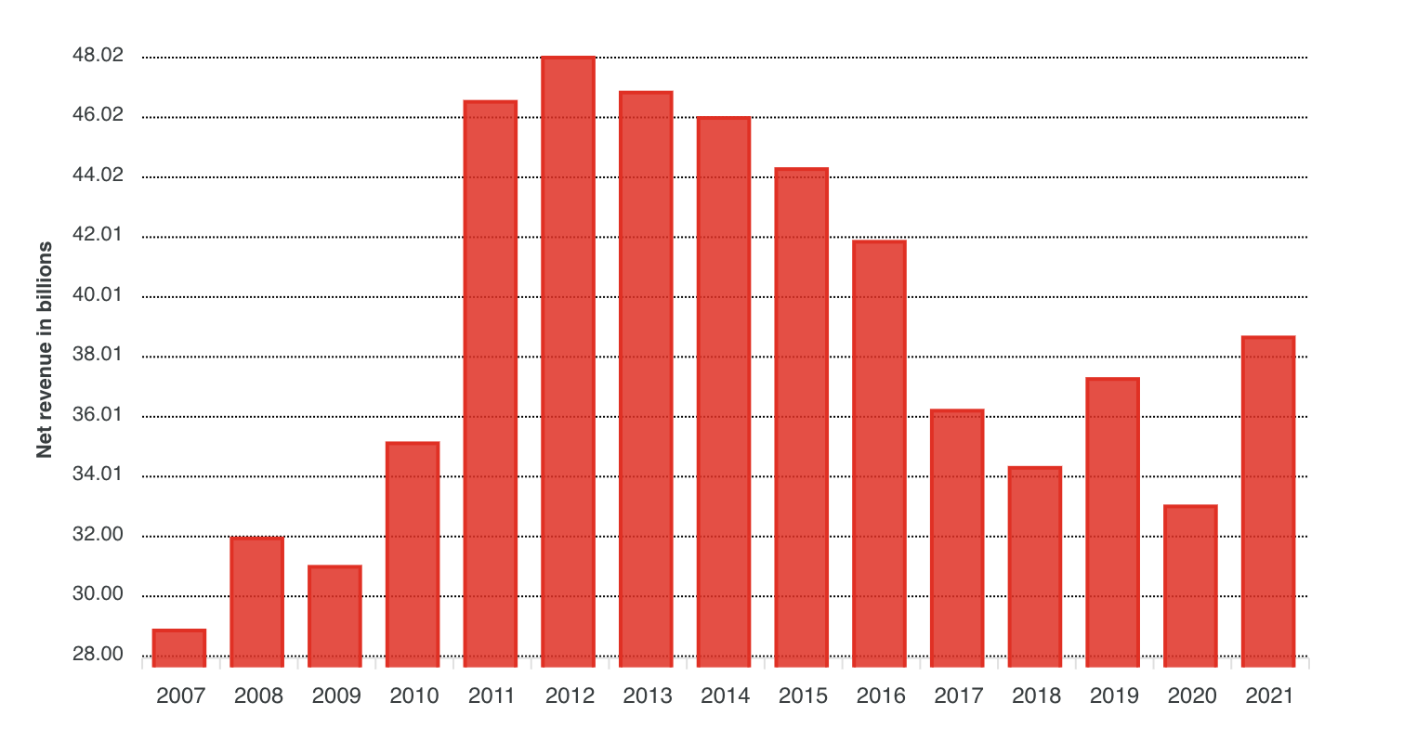
activities
activities
Coca cola revenues
https://wpdatatables.com/misleading-data-visualization-examples/
Notes:
Do the shapes represent the data precisely (without approximation)? NO Oh boy. Can anyone here estimate the volume of the hairy balls with flying fibers? (BTW, I you want to quote this article, quote this sentence).

Slide 40
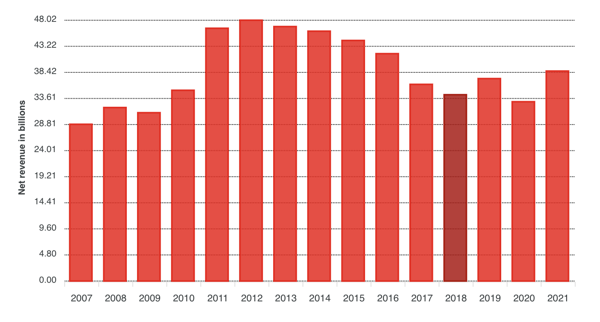
activities
activities
Coca cola revenues
https://wpdatatables.com/misleading-data-visualization-examples/
Notes:
Do the shapes represent the data precisely (without approximation)? NO Oh boy. Can anyone here estimate the volume of the hairy balls with flying fibers? (BTW, I you want to quote this article, quote this sentence).

Slide 41
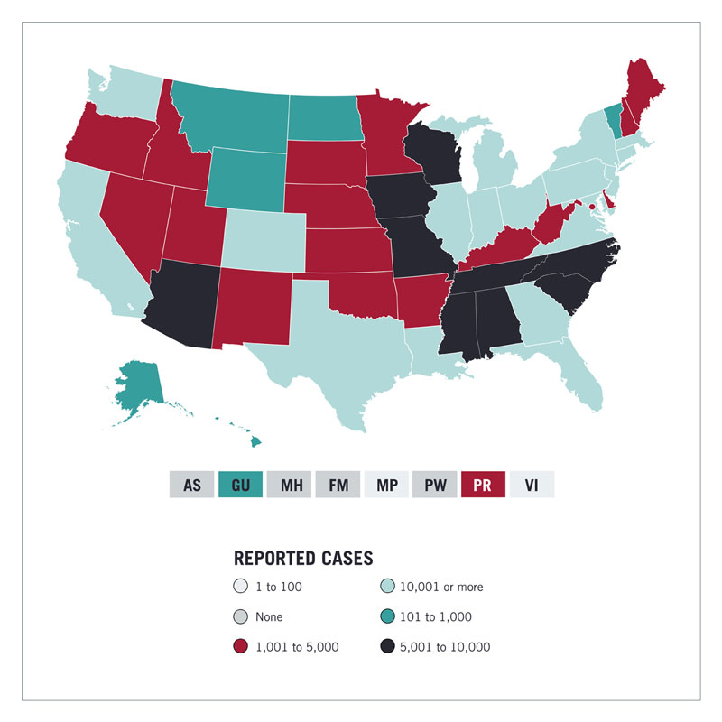
activities
https://wpdatatables.com/misleading-data-visualization-examples/
Notes:
The darker the color, the higher the infection rate.

Slide 42
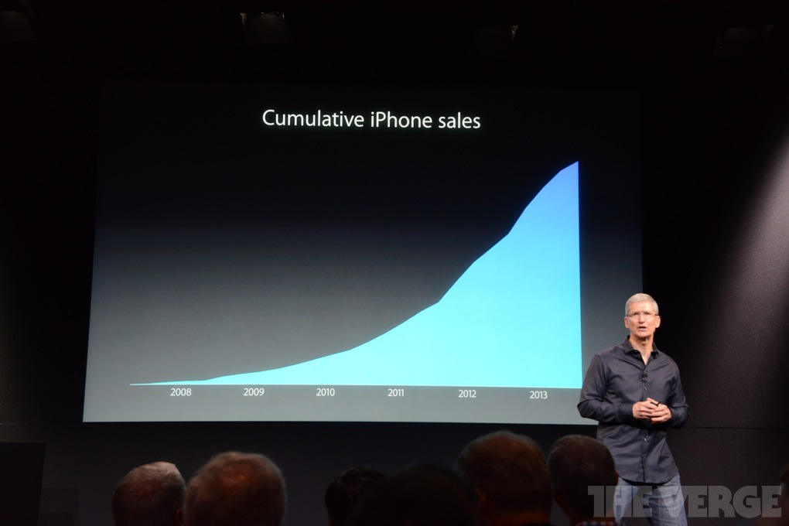
activities
https://www.techjunkie.com/tim-cook-trying-prove-meaningless-chart/
Notes:
Apple CEO Tim Cook in 2013

Slide 43
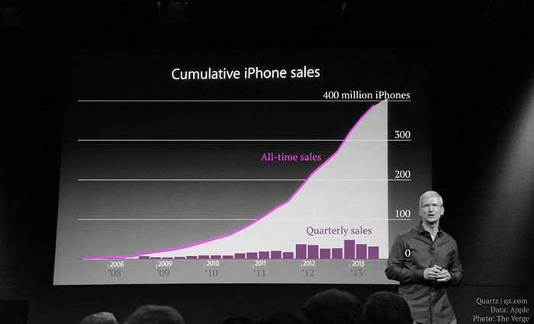
activities
https://www.techjunkie.com/tim-cook-trying-prove-meaningless-chart/
Notes:
Do the shapes represent the data precisely (without approximation)? NO Oh boy. Can anyone here estimate the volume of the hairy balls with flying fibers? (BTW, I you want to quote this article, quote this sentence).

Slide 44
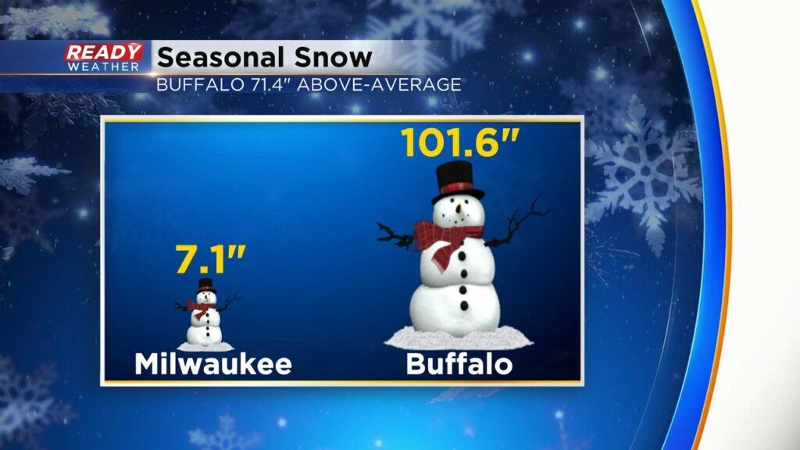
activities
https://policyviz.com/2023/02/07/10-ways-to-mislead-with-data-visualization/
Notes:
Do the shapes represent the data precisely (without approximation)? NO Oh boy. Can anyone here estimate the volume of the hairy balls with flying fibers? (BTW, I you want to quote this article, quote this sentence).

Slide 45
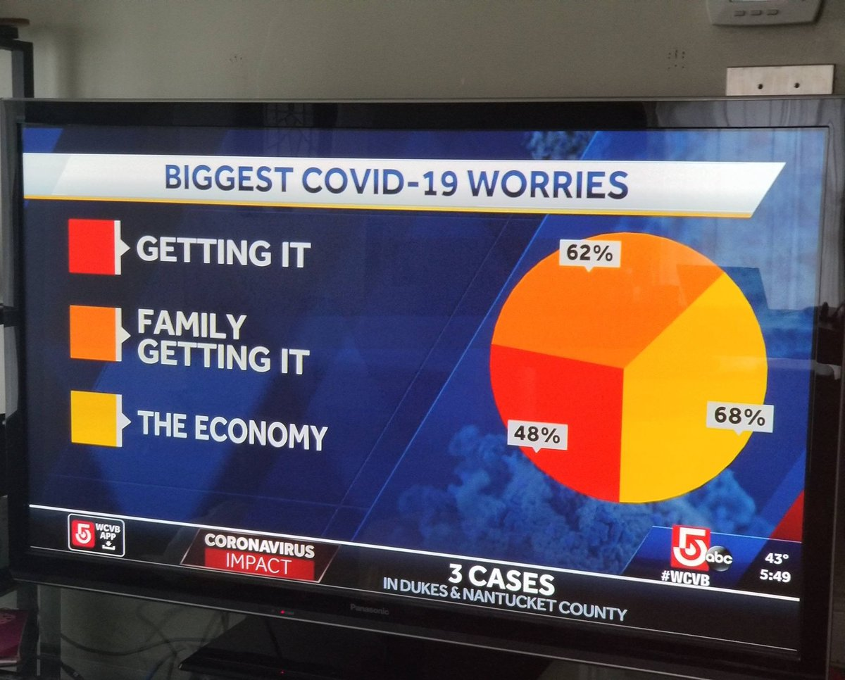
activities
https://policyviz.com/2023/02/07/10-ways-to-mislead-with-data-visualization/
Notes:
Do the shapes represent the data precisely (without approximation)? NO Oh boy. Can anyone here estimate the volume of the hairy balls with flying fibers? (BTW, I you want to quote this article, quote this sentence).

Slide 46

activities
https://policyviz.com/2023/02/07/10-ways-to-mislead-with-data-visualization/
Notes:
Do the shapes represent the data precisely (without approximation)? NO Oh boy. Can anyone here estimate the volume of the hairy balls with flying fibers? (BTW, I you want to quote this article, quote this sentence).

Slide 47
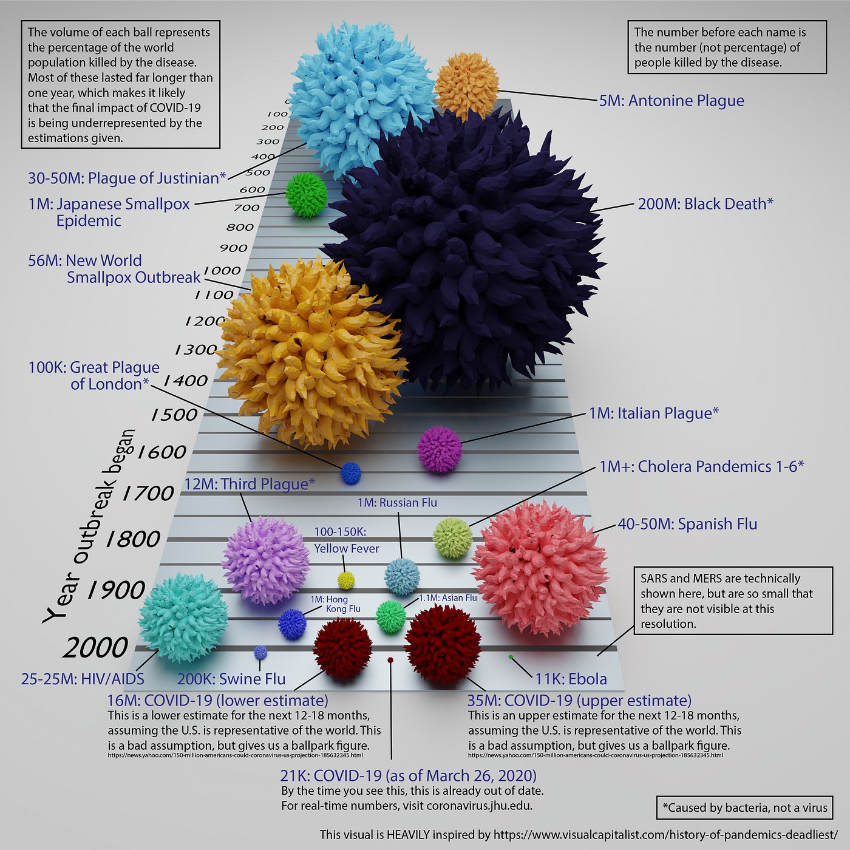
activities
https://towardsdatascience.com/why-is-this-chart-bad-5f16da298afa
Notes:
Do the shapes represent the data precisely (without approximation)? NO Oh boy. Can anyone here estimate the volume of the hairy balls with flying fibers? (BTW, I you want to quote this article, quote this sentence).

Slide 48
material
Material, slides, code, exercises, activities
https://github.com/neelsoumya/visualization_lecture
Derivations and technical details
https://github.com/neelsoumya/visualization_lecture/blob/main/mathematics_data_science.pdf
https://osf.io/mnh8d/

Slide 49
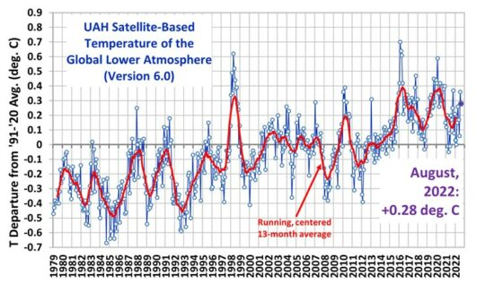
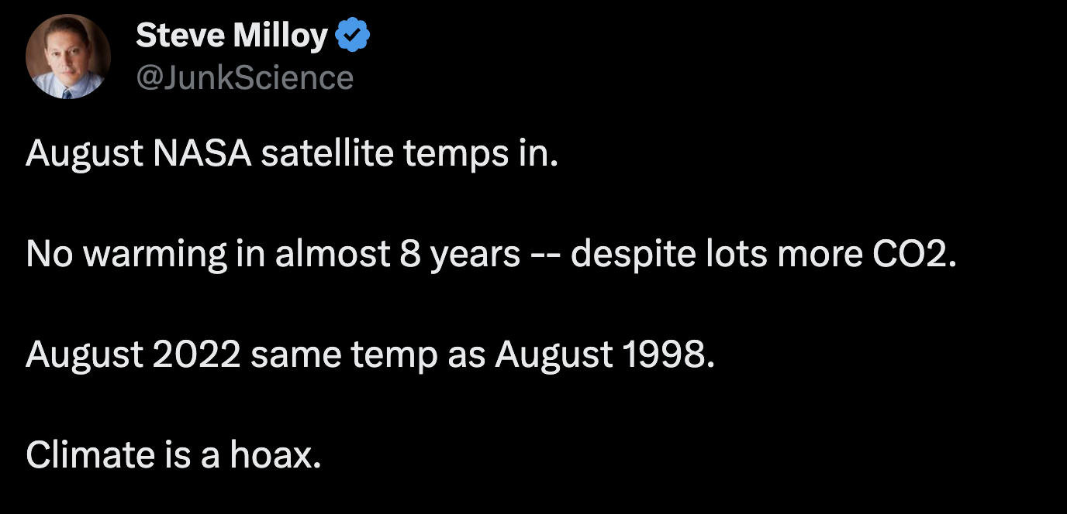
https://www.drroyspencer.com/2022/09/uah-global-temperature-update-for-august-2022-0-28-deg-c/
Notes:
Regression towards the mean
Satellite measures temperatures

Slide 50
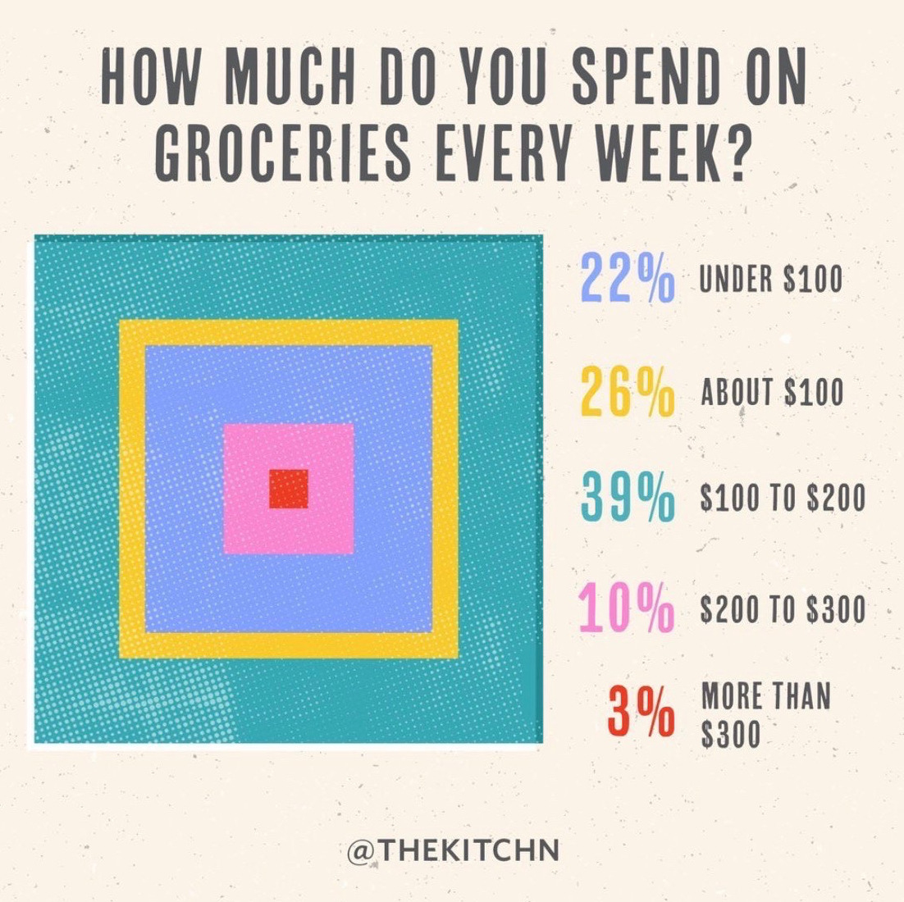
https://viz.wtf/
Notes:
Regression towards the mean
Satellite measures temperatures

Slide 51
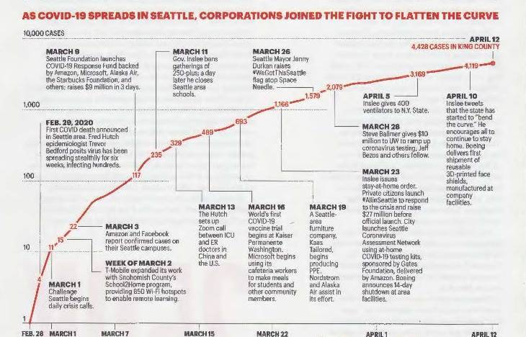
https://viz.wtf/
Notes:
Regression towards the mean
Satellite measures temperatures

Slide 52
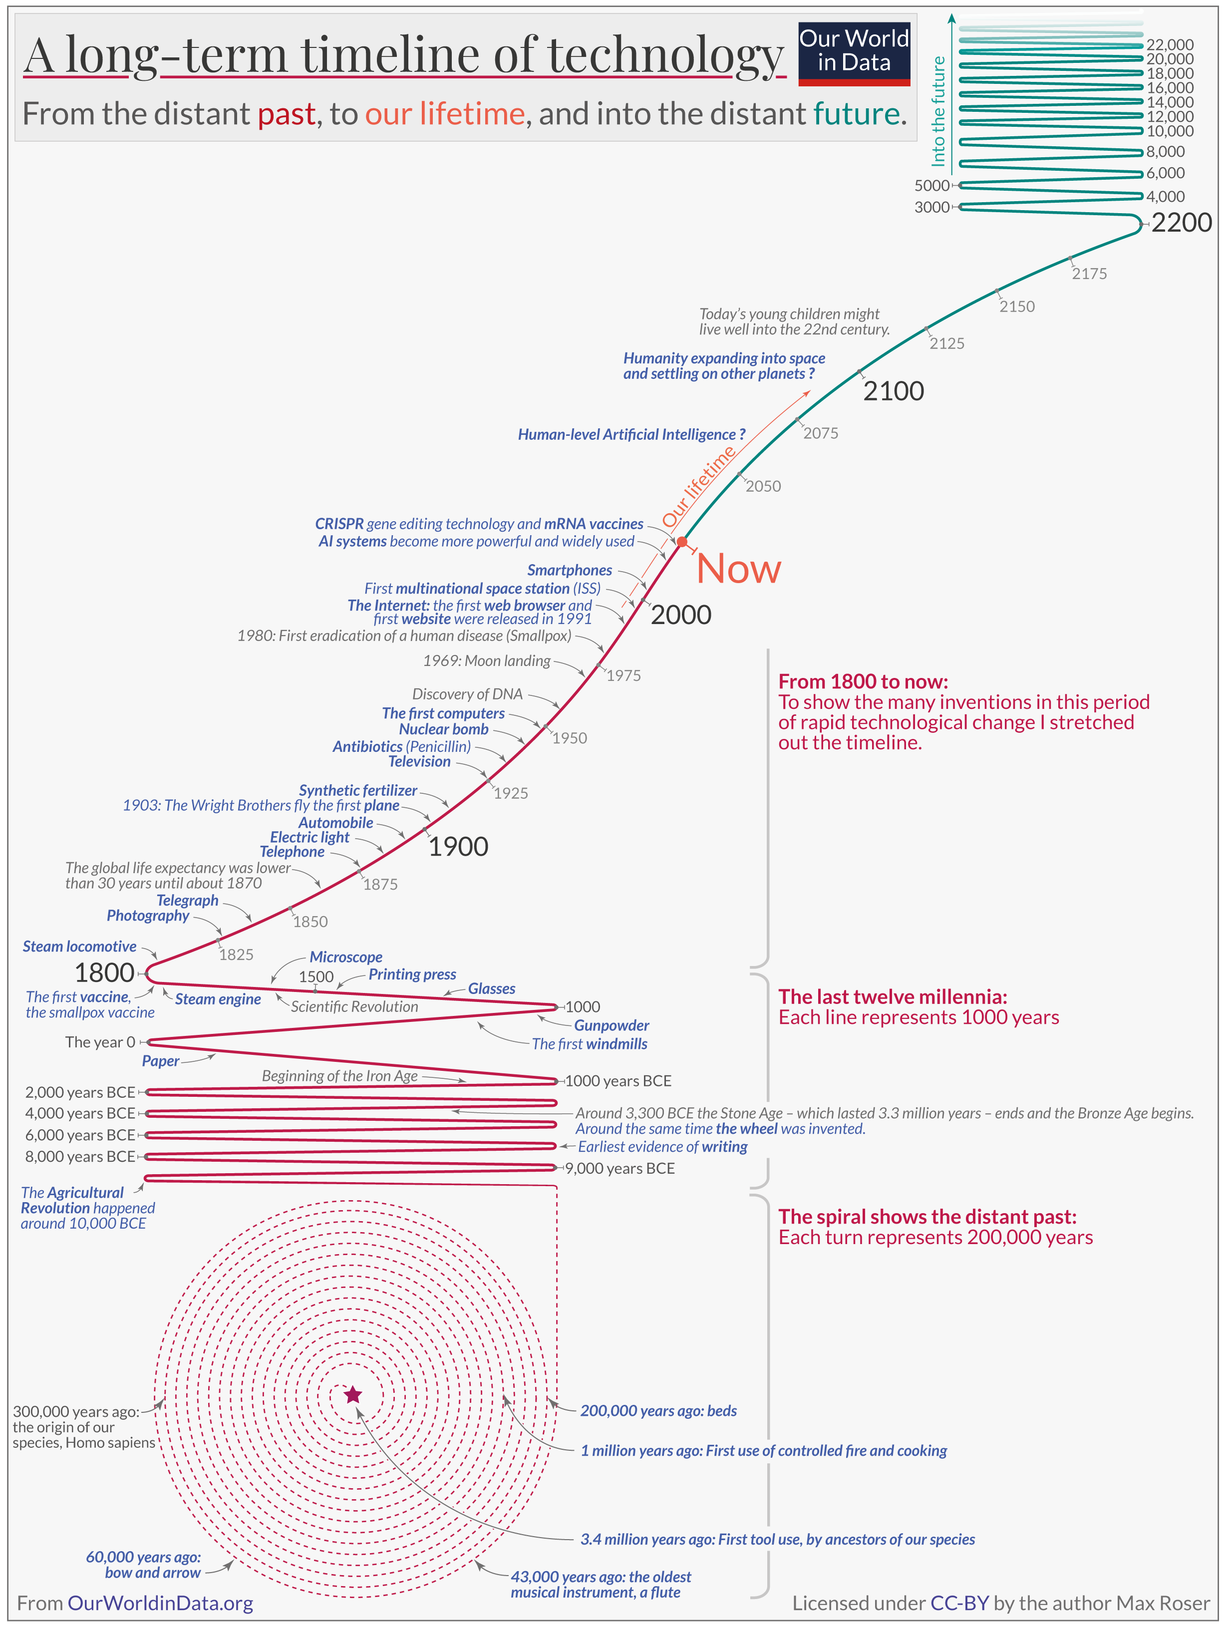
activities
https://ourworldindata.org/technology-long-run
Notes:
Do the shapes represent the data precisely (without approximation)? NO Oh boy. Can anyone here estimate the volume of the hairy balls with flying fibers? (BTW, I you want to quote this article, quote this sentence).

Slide 53
activities
North korea missile range animation
Critique
https://nagix.github.io/nk-missile-tests/

Slide 54
Interactive Data storytelling
https://pudding.cool/projects/heat-records-map/
2. https://pudding.cool/2022/12/yard-sale/
3. https://www.gapminder.org/tools/#$chart-type=bubbles&url=v1

Slide 55
activities
Create cartogram online
https://go-cart.io/tutorial

Slide 56
activities
Create interactive data visualization
https://www.gapminder.org/tools/#$chart-type=bubbles&url=v1
https://ourworldindata.org/grapher/artificial-intelligence-training-computation?time=earliest..2023-10-11

Slide 57
activities
https://wpdatatables.com/data-visualization-examples/
https://wpdatatables.com/misleading-data-visualization-examples/
https://policyviz.com/2023/02/07/10-ways-to-mislead-with-data-visualization/

Slide 58
Time series data and autocorrelations
Seasonality
autocorrelations
Notes:
https://statisticsbyjim.com/regression/log-log-plots/

Slide 59
Time series data
Visualizing the data (for example, time-series data) can reveal what kinds of models would be appropriate. For example, if time series data has some seasonality, then a seasonal auto-regressive model (SARIMA) may be appropriate.
Visualization may also reveal if the underlying model/assumptions may have changed after a certain time. For example, in financial time-series data, there usually is a change after 2008 due to the global financial crisis.
This may suggest that a new model or more data is required.
Notes:
Example of IL10 project (tSNE and heatmaps from a bioinformatics project)

Slide 60

Time series data
Generalized Linear model
Notes:
Example of IL10 project (tSNE and heatmaps from a bioinformatics project)

Slide 61

Notes:
Example of IL10 project (tSNE and heatmaps from a bioinformatics project)

Slide 62

Notes:
Example of IL10 project (tSNE and heatmaps from a bioinformatics project)

Slide 63
Design matrix Glm Correlated periodic Exponential Hiow to pick How do I get to this out of data How do I communicate this to stakeholders More tools for data visualization Generate data Visualize it High dumenosional data Results visualizE Communicate this Cancer woring link winter environmental actiivis Rachel carson silent spring pitfalls prob visualize
Notes:
Example of IL10 project (tSNE and heatmaps from a bioinformatics project)

Slide 64

UN logo
Notes:
Example of IL10 project (tSNE and heatmaps from a bioinformatics project)

Slide 65
Time series data
Assumptions
Similar to linear regression/GLM (VAR model/ARIMA)
Look at correlations
Simpler models are better (moving averages better than anything fancy/ML)
Notes:
Example of IL10 project (tSNE and heatmaps from a bioinformatics project)

Slide 66
Data bias
Gorilla experiment (selective attention bias)
Hermann Hesse quote seeking is different to finding
Notes:
Example of IL10 project (tSNE and heatmaps from a bioinformatics project)

Slide 67

Case study
Notes:
Example of IL10 project (tSNE and heatmaps from a bioinformatics project)

Slide 68
Bad visualizations
Notes:
Multiple dimensions on one plot
Code and data available see PDF

Slide 69
Basics and pitfalls in data visualization 1. Know your audience 2. Pick visualization based on audience 3. Visualize data and then pick models 4. Add narrative
Notes:
Example of IL10 project (tSNE and heatmaps from a bioinformatics project)

Slide 70

Notes:
Example of IL10 project (tSNE and heatmaps from a bioinformatics project)

Slide 71
assumptions
Linearity (linear relationship between data points and lower dimensional representation)
Loss function/reconstruction error (squared loss)
Uses the dot product (one type of inner product)

Slide 72
Time series data
Visualizing the data (for example, time-series data) can reveal what kinds of models would be appropriate.
For example, if time series data has some seasonality, then a seasonal auto-regressive model (SARIMA) may be appropriate.
Visualization may also reveal if the underlying model/assumptions may have changed after a certain time. For example, in financial time-series data, there usually is a change after 2008 due to the global financial crisis.
This may suggest that a new model or more data is required.
Generalized Linear model
Notes:
Possibly skip

Slide 73

Absence of influential data points
Run the analysis with and without influential data points
Notes:
https://statisticsbyjim.com/regression/log-log-plots/

Slide 74
Case studies
removing outliers in genomic data using PCA.
Frequently in genomic data we may have to remove outliers. These outliers may be due to technical/batch effects or unknown reasons not connected to biology.
This has implications for any tests performed downstream. For example, t-tests can be performed downstream after performing PCA. If there are outliers, it may affect the results of the t-test. application to bulk and single-cell sequencing data.

Slide 75
Absence of influential data points
1. Removing outliers and then some downstream processing
2. t-test
3. Run the analysis and without and with the data point
Notes:
Example of IL10 project (tSNE and heatmaps from a bioinformatics project)

Slide 76

independence
Study design
Mixed effects models
Notes:
Possibly skip

Slide 77
Visualizations can be misleading
Notes:
Design effect

Slide 78
1. Less is more. “Above all else show the data” (INK SPACe MAXIMIZE) 2. Keep it proportional! “Lie Factor = size of effect shown in graphic divided by size of effect in data”
Principles of data visualization (Edward tufte)
https://jeffhale.medium.com/five-takeaways-from-the-visual-display-of-quantitative-information-dd36dae35299
Notes:
Example of IL10 project (tSNE and heatmaps from a bioinformatics project)

